Slide 1
Microsoft teams

Slide 2

Communication
Microsoft teams is the main method of general communication at DDHS.
This is the same between primary and secondary school.
2

Slide 3
About
Microsoft Teams is a department software, which can be accessed on your desktop computer.
You can use the web browser or download the app on your computer.
It can also be downloaded as an app on your mobile phone. There is no obligation to have it on your phone.
It must be used as a form of communication.
Log In | Microsoft Teams
This link works!

Slide 4
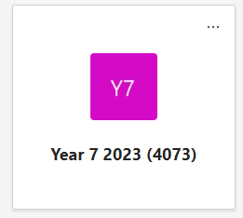
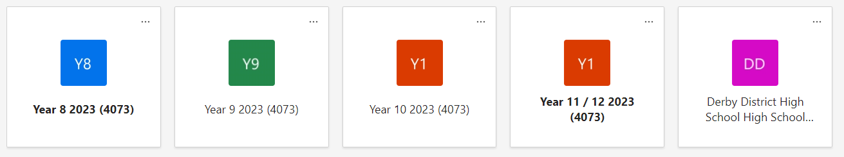
How to use
And we have a High School all staff room.
Each class has their own PLC group.

Slide 5
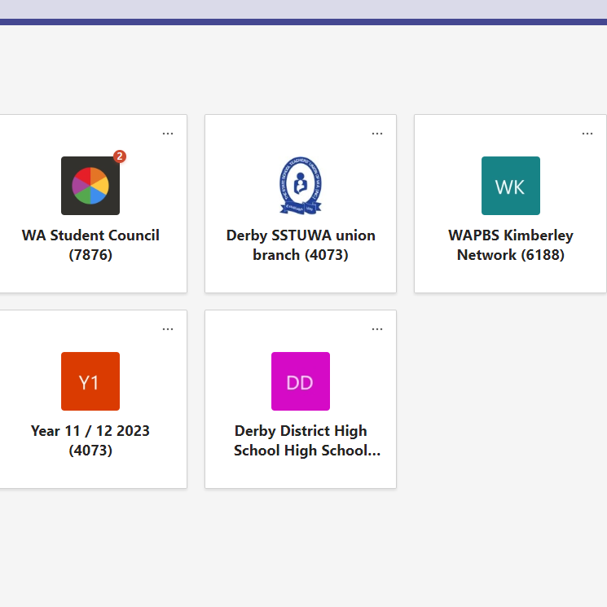
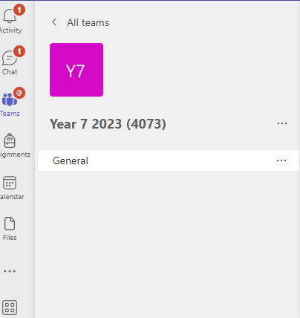
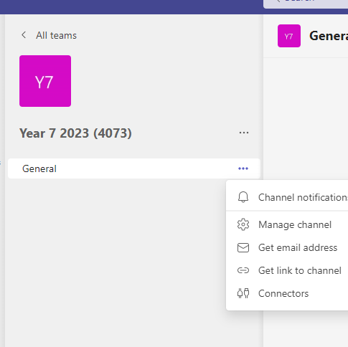
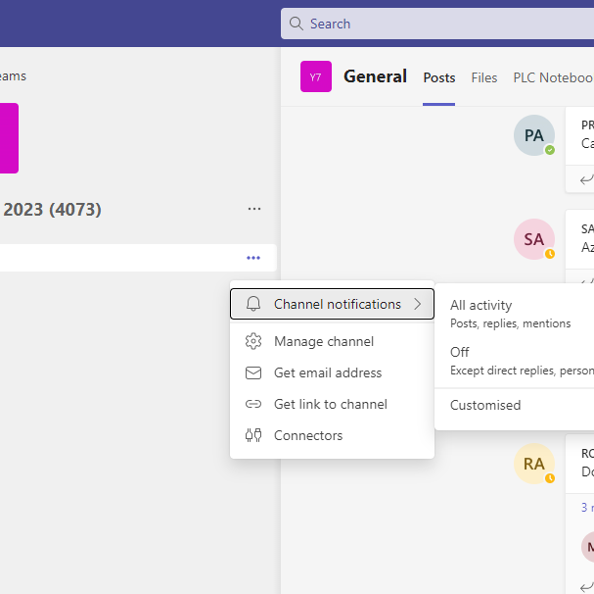
Notifications
Step 1
Step 2
Go to the allocated ‘TEAM’
Click on the … next to General
Step 3
Step 4
Channel notifications
All Activity

Slide 6

When to use Microsoft teams
When staff need to be aware of a situation that may impact a student in the day. E.G. lack of sleep.
When a student has left class.
When student services or a deputy is required to assist with a buddy class.
Office staff may notify if students need a direct message e.g. regarding lunch or the bus.

Slide 7
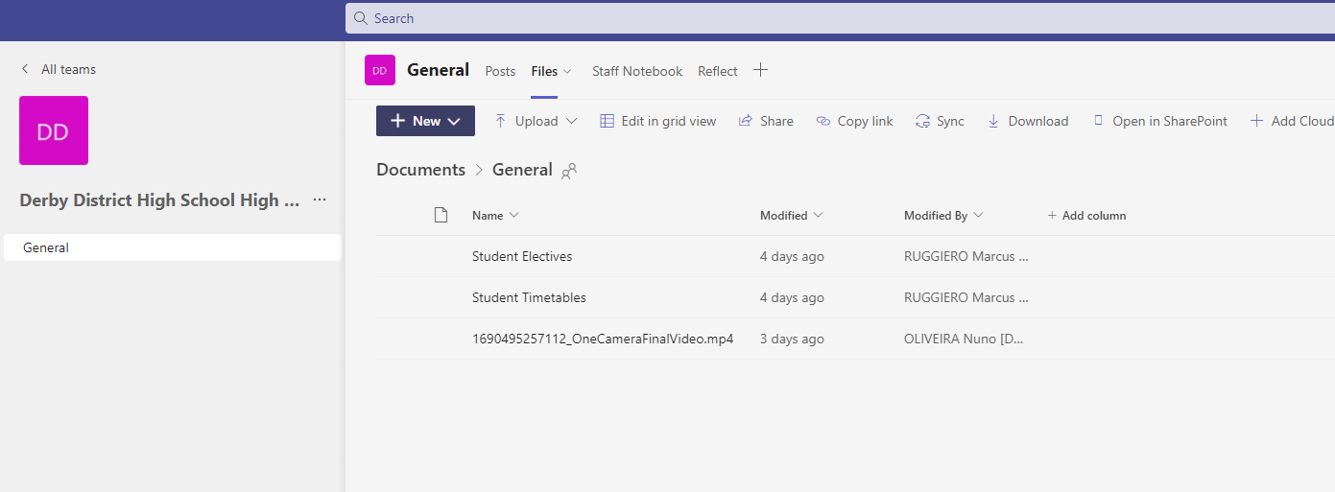
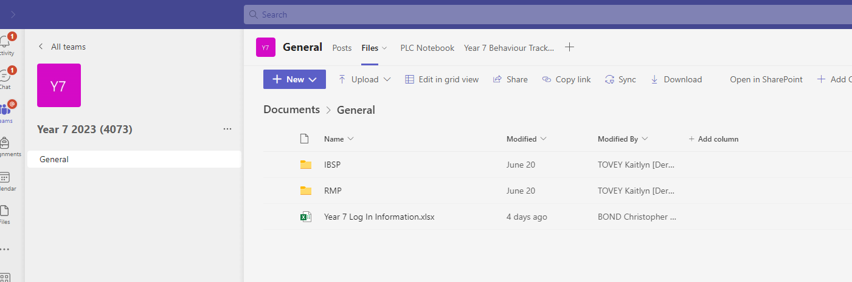
General Information
Do not use Microsoft teams in an emergency – this needs to be a phone call.
A member of student services or a deputy will react to your message to ensure it has been accounted for.
Anything on a class post of Microsoft teams must become a SIS entry.
As they are set up as PLC’s we can store files and other information in the year group.

